Slide 1
Group 6: Farming Simulator
Robbie Mundle, Yucheng Liu, Jake Boyle, Arnold Zoundi, Nasser Al-Maadeed

Slide 2
Project Description
Increase awareness of the social and economic difficulties of farming in the mid 19th century
Dealing with rent payments which are controlled by the land owner
Rack Renting: Sub-dividing land into smaller units while increasing the rent costs

Slide 3
Implemented User Stories
As a player I want to have farming tools of the era to help with my farm’s needs.
As a player I want to be charged fees at the end of the month for basic needs, as this will show the difficulties facing farmers in that time period.

Slide 4
Implemented User Stories
As a player I want to be able to see the status of my farm and the daily weather conditions.
As a player I want to be able to choose a difficulty setting.

Slide 5






Tools (19th Century)
Reaper
Scythe
Hand pushed plough
Garden Hoe
Shovel
Irrigation Tool

Slide 6

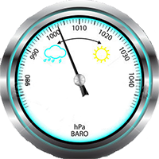



Items
Pocket Watch
Dollar Bill
Barometer
Newspaper
Inventory Monitor

Slide 7
Main Objective
Player starts with tools listed in previous slides
Player has 5 days until rent money will be withdrawn from inventory via Inventory Monitor
After 1 week rent due will increase (rack renting)
Player can exchange various foods and crops for currency
If rent is NOT paid, then player is penalized a strike
After three strikes, game is over

Slide 8
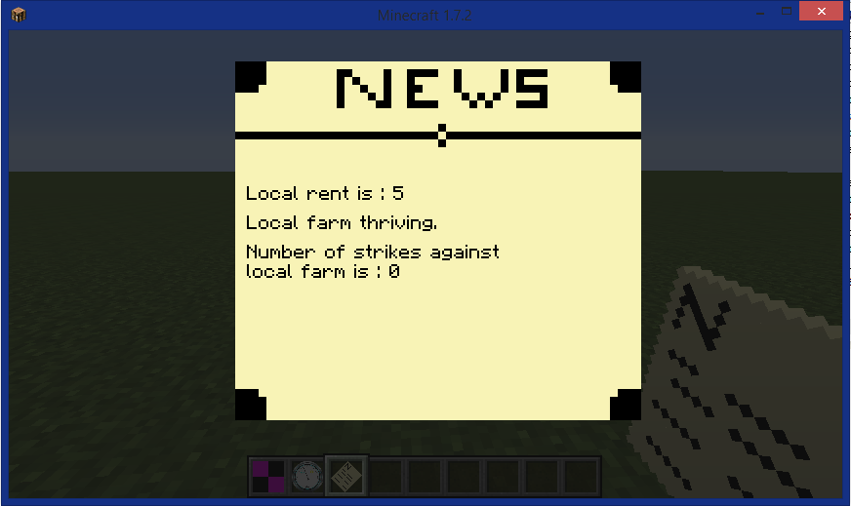
Game Status
Can be read from the newspaper
States number of strikes

Slide 9
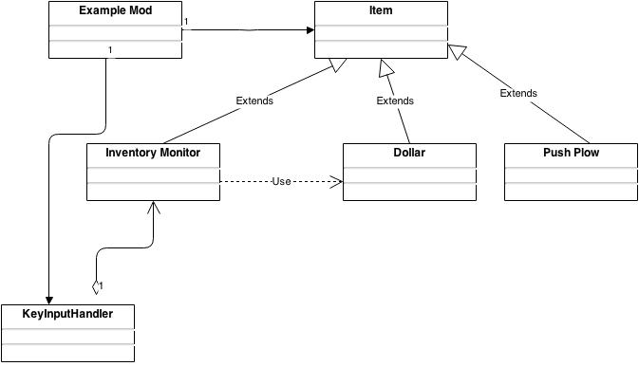
Software Structure

Slide 10
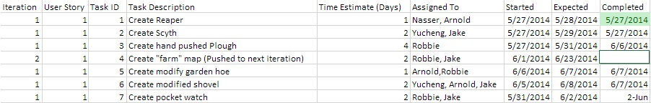
Task Breakdown
All charts were stored on OneDrive so that all members could have access

Slide 11
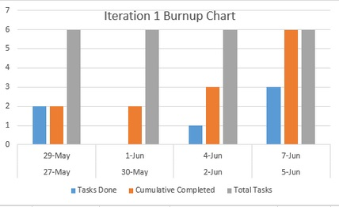
Burnup Chart

Slide 12
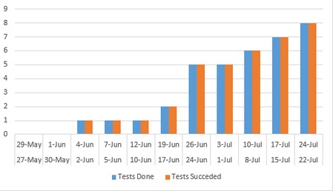
Testing via ANT and JUnit
Notes:
regression

Slide 13
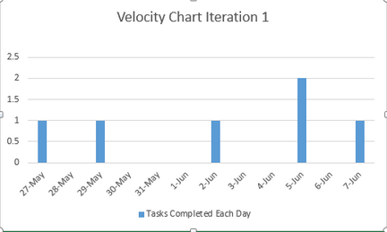
Velocity Chart

Slide 14
Difficulties
Understanding the minecraft source code
Lack of comments
Unclear method names
Reverse tracing method calls
SVN used with Eclipse
Commit and update
Understanding client and server code execution
Double method calls

Slide 15
Sources
https://www.youtube.com/watch?v=WfAKqOVKge0
https://www.youtube.com/watch?v=kLR0swh-CeE
https://www.youtube.com/watch?v=w676ULysyvw
https://www.youtube.com/watch?v=PlluCNWSe2A
https://www.youtube.com/watch?v=kLR0swh-CeE
https://www.youtube.com/watch?v=w676ULysyvw
https://www.youtube.com/watch?v=PlluCNWSe2A
https://www.youtube.com/watch?v=-4ZY35Gthk0

Slide 16
Sources Continued
https://www.youtube.com/watch?v=-4ZY35Gthk0
http://www.planetminecraft.com/project/the-noobs-guide-to-creating-texture-packs/
http://www.minecraftrecipedesigner.com/
http://www.minecraftforge.net/forum/index.php?topic=6514.0
http://www.historyplace.com/worldhistory/famine/introduction.htm
http://www.minecraftforge.net/forum/index.php?topic=3544.0
http://www.minecraftforum.net/forums/mapping-and-modding/mapping-and-modding-tutorials/1571567-1-7-2-1-6-4-eventhandler-and
https://forums.bukkit.org/threads/prevent-players-from-throwing-items.143767/
http://mcreator.pylo.si/forum/5700/correct-gui-alignment-custom-images-gui-not-so-advanced
https://www.youtube.com/watch?v=2BSTpgRIMbs

